Slide 1
WELCOME
2014 Youth Kickoff
Potluck Dinner

Slide 2
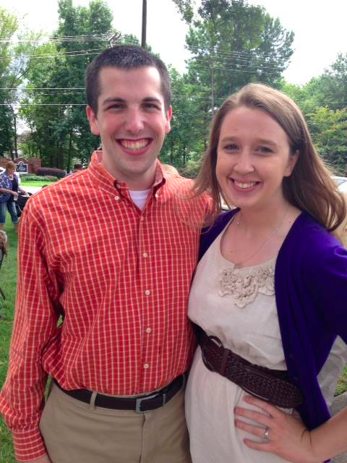
Staff
Graham Hughes
Contact Info
Cell: (828)310-1433
Email: gkhughes31@gmail.com
Facebook: Graham Hughes at CMPC
Instagram: InstaGrahamCMPC

Slide 3
Advisors
Dinah Riggs
And you?

Slide 4
Website
www.cmpcyouth.weebly.com
Site is also linked on the main page: cookschurch.org

Slide 5
Sunday School
Meets Sunday morning @ 9 AM
Room 208
Watch movies and apply the lessons we learn in them to scripture as well as real life

Slide 6
Youth Group
We will meet most Sundays at Cook’s
6pm-7:15pm
Fun, fellowship, devotion, study, games, prayer, and more!
We will also have other fellowship events throughout the year
Look for emails, bulletin inserts, and the Communicator for news

Slide 7
Missions
Church workday: a Saturday TBD @ Cook’s
Faithful Feet Walk: 9/28 after church @ Cook’s
30 Hour Famine/End Hunger Now, other ideas
Summer Mission Trip?
If you are looking for hours for a service group or school, let me know and I will contact them to see if we can work something out.

Slide 8
Friend Policy
Friends are ALWAYS welcome!
You are free to bring friends anytime to Sunday School or Youth Group.
If you would like a friend to go on a trip with us, they must attend one youth group meeting first.

Slide 9
Cell Phone Policy
Will be placed in a special box during Sunday School and Youth Group
If are not placed in the box, they will be taken if seen or heard.
Cell phones are allowed on trips - specific guidelines will be given each trip on when/where they may be used

Slide 10
Announcements
Corn Maze, next Sunday 9/21
After church @ 1 o’clock
No youth group that night
Faithful Feet Walk, 9/28
Right after church
Lunch will be served for walkers
We WILL still have youth group at 6pm

Slide 11
Child Protection Policy
In the process of being edited.
Full copy is available on the Youth and Children Ministries page under Resources
Abridged version is posted in all classrooms in the church.

Slide 12
Information Form
Please take this time to fill out the information form.
This form is required before a youth participates in an activity or trip beyond regular Sunday night fellowship without direct parent supervision.

Slide 13
Consent Form
Please take this time to read over the consent form.
Participation
Transportation
Medical Treatment
Photography
Communication

Slide 14
Youth Ministry Standards
Please take this time to look over the CMPC Youth Ministry Standards form.
Once all forms are completed and signed please return it to Graham Hughes.

Slide 15
Adult Chaperones
We want you to be involved!
Take adults in first come first serve manner
Youth Ministry covers the expenses for the required number of adults
If you are not included in the required number you are always welcome to join us, paying your way
Under the Child Protection Policy, any parent/legal guardian is allowed to sit in on any youth event without prior warning.

Slide 16
Discipline
Youth Staff or Volunteer will speak to youth individually
Parents will be called or notified if problem persists or is serious enough
Youth will be removed from the event at parents
expense and inconvenience
Participation in events may be limited

Slide 17
Fundraising
Ideas?

